Slide 1


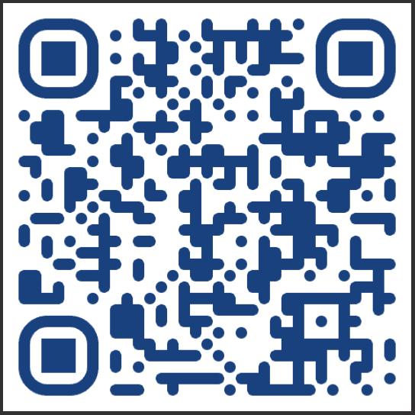
July 23, 2025
Call for more information:
901-416-4180
Ask for Counselor Jackson
Registration Link
https://forms.office.com/pages/responsepage.aspx?id=lBwpK7Bet0SJ6kuvFuzEqYuPrPcx1AFJgCRwqRuMO05UM1JBWUpBUktUNTRCRDBTQU9ETzRFUEU2MC4u&route=shorturl

